Slide 1
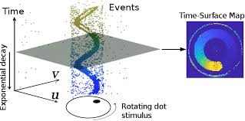

Final Presentation Denoising Event Cameras
Students: Bar Weiss, Asaf Omer
Supervisor: Yonatan Shadmi
Semester: Spring, 2022
Date: 31/01/23
In collaboration with: Rafael Advanced Defense Systems via Nimrod Kruger

Slide 2
Project Goal
Focus on Threshold Mismatch Effect
Create Simulation Environment
Isolate threshold mismatch effect
Explore it further
Develop Novel Algorithm for Correction
Notes:
אסף

Slide 3
Agenda
Background
Noise Sources
Simulation Environment
Threshold Estimation and Correction
Performance Analysis
Conclusions and Future Work
Notes:
אסף

Slide 4
Agenda
Background
Noise Sources
Simulation Environment
Threshold Estimation and Correction
Performance Analysis
Conclusions and Future Work

Slide 5
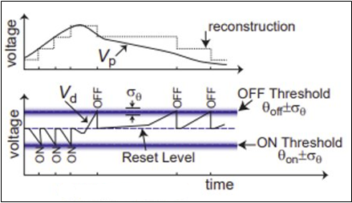
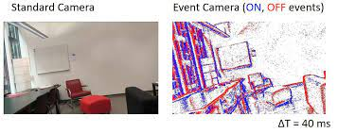
What is an Event Camera?
Event Cameras detect changes in brightness levels, allow fine temporal resolution and high dynamic range
Operating Principle
Example of Data
Yuhuang Hu et al, “v2e: From Video Frames to Realistic DVS Events”
Notes:
בר

Slide 6
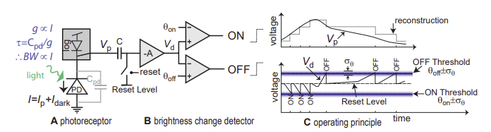
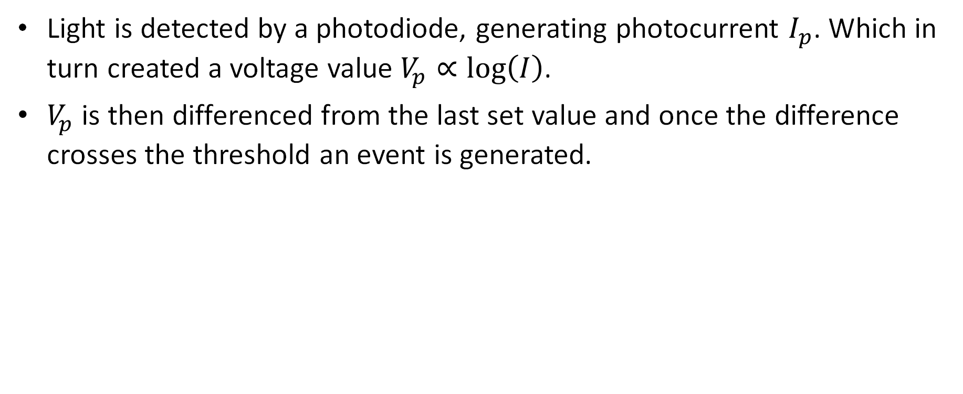
Circuit Operation
Light is detected by a photodiode, generating photocurrent $I_{p}$. Which in turn created a voltage value $V_{p}∝\log\left(I\right)$.
$V_{p}$ is then differenced from the last set value and once the difference crosses the threshold an event is generated.
Yuhuang Hu et al, “v2e: From Video Frames to Realistic DVS Events”
Notes:
בר

Slide 7
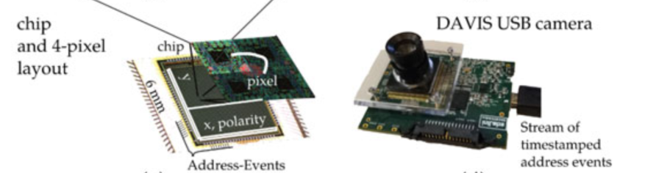
Advantages
High temporal resolution
Sparse data Representation
Low power vision sensing
High Dynamic Range
Guillermo Gallego et al, “Event-Based Vision: A Survey”
Notes:
אסף

Slide 8
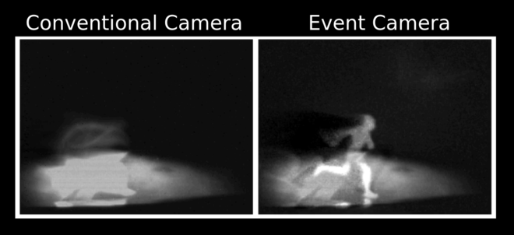
Applications
Autonomous vehicles
Object recognition
Object Tracking
Robotics
Surveillance
Scheerlinck, Cedric; Barnes, Nick; Mahony, Robert (2019). "Continuous-Time Intensity Estimation Using Event Cameras"
Notes:
אסף

Slide 9
Challenges
Limited research was done
Lacking Noise models and filtering methods (our project)
Different representation does not allow reuse of VIS algorithms
Notes:
אסף

Slide 10
Agenda
Background
Noise Sources
Simulation Environment
Threshold Estimation and Correction
Performance Analysis
Conclusions and Future Work
Notes:
בר

Slide 11
Noise Sources
Background Activity
Threshold mismatch
Shot Noise
Hot / Cold Pixels
Notes:
בר

Slide 12
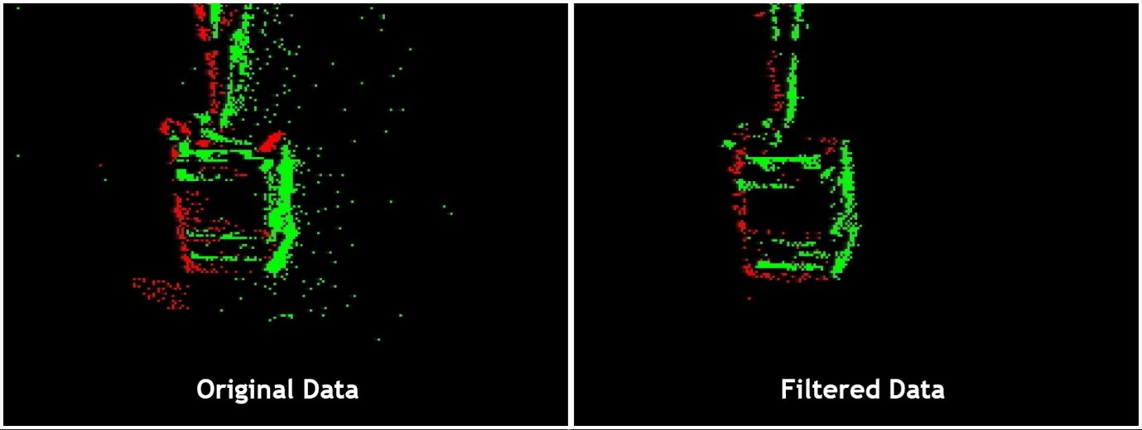
Background Activity
Background activity (BA) noise refers to a group of noise mechanisms.
These noise mechanisms cause generation of events under constant illumination.
Notes:
בר

Slide 13
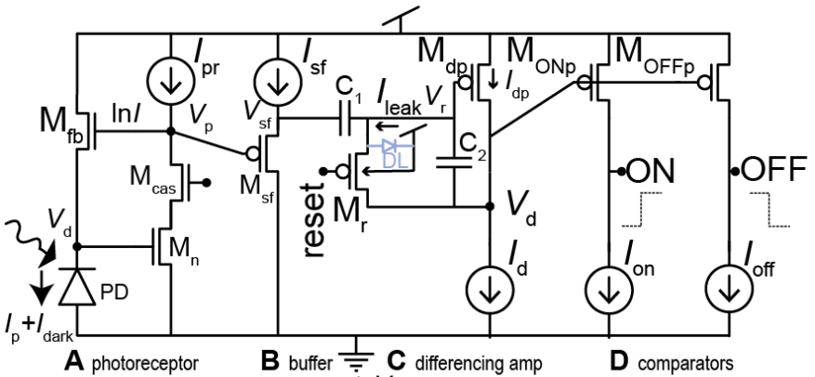
Background Activity - Causes
BA sources are phenomena such as charge injection, leakage current of the transistors, thermal noise and dark current.
Yuji Nozaki and Tobi Delbruck, “Temperature and Parasitic Photocurrent Effects in Dynamic Vision Sensors”
Notes:
בר

Slide 14
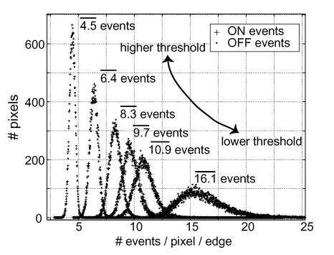
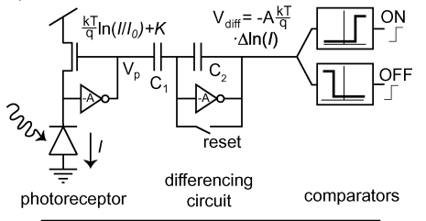
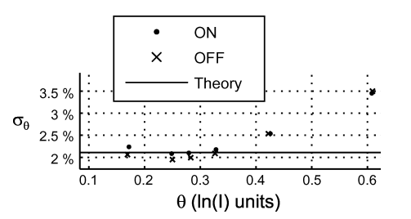
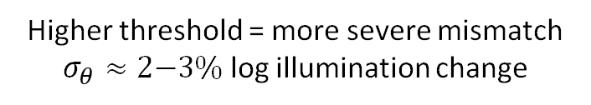
Threshold Mismatch
Due to a non-ideal manufacturing process, the contrast threshold value for each pixel is different
Mismatch higher in transistors, reset and comparator circuits more susceptible
Higher threshold = more severe mismatch $σ_{θ}≈2\text{−}3\%$ log illumination change
Lichtsteiner, P; Posch, C; Delbruck, T, “A 128× 128 120 dB 15 μs latency asynchronous temporal contrast vision sensor”
Notes:
אסף

Slide 15
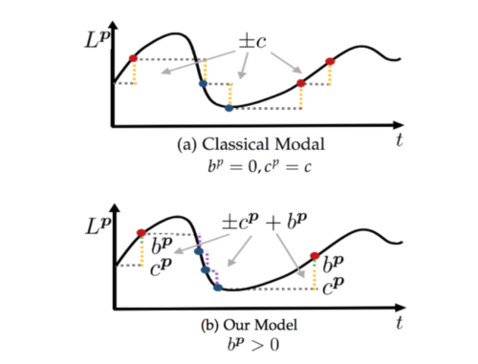
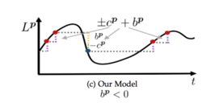

Threshold Mismatch – Bias Effect
In a more developed model of the Threshold Mismatch, the pixel's bias towards generating positive vs. negative events also changes.
$$p_{i}^{x}=\left\{\begin{aligned}&+1, ΔL^{x}\left(t_{i}^{x}\right)≥c^{x}+b^{x} \\ &−1, ΔL^{x}\left(t_{i}^{x}\right)≤−c^{x}+b^{x}\end{aligned}\right.$$
Ziwei Wang et al, "Event Camera Calibration of Per-pixel Biased Contrast Threshold"
Notes:
אסף

Slide 16
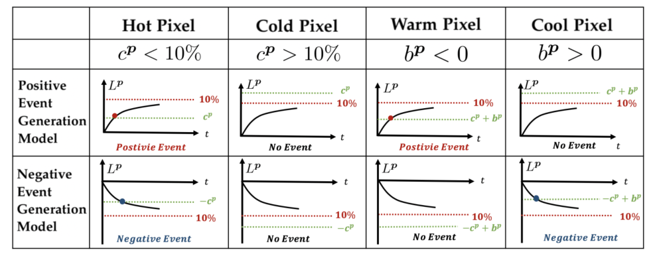
Threshold Mismatch – Nonuniformity Effect
Threshold mismatch causes nonuniformity between the different pixels, meaning each pixel will generate a different number of events at different timestamps given the same stimulus.
Ziwei Wang et al, "Event Camera Calibration of Per-pixel Biased Contrast Threshold"
Notes:
אסף

Slide 17
Agenda
Background
Noise Sources
Simulation Environment
Threshold Estimation and Correction
Performance Analysis
Conclusions and Future Work
Notes:
בר

Slide 18
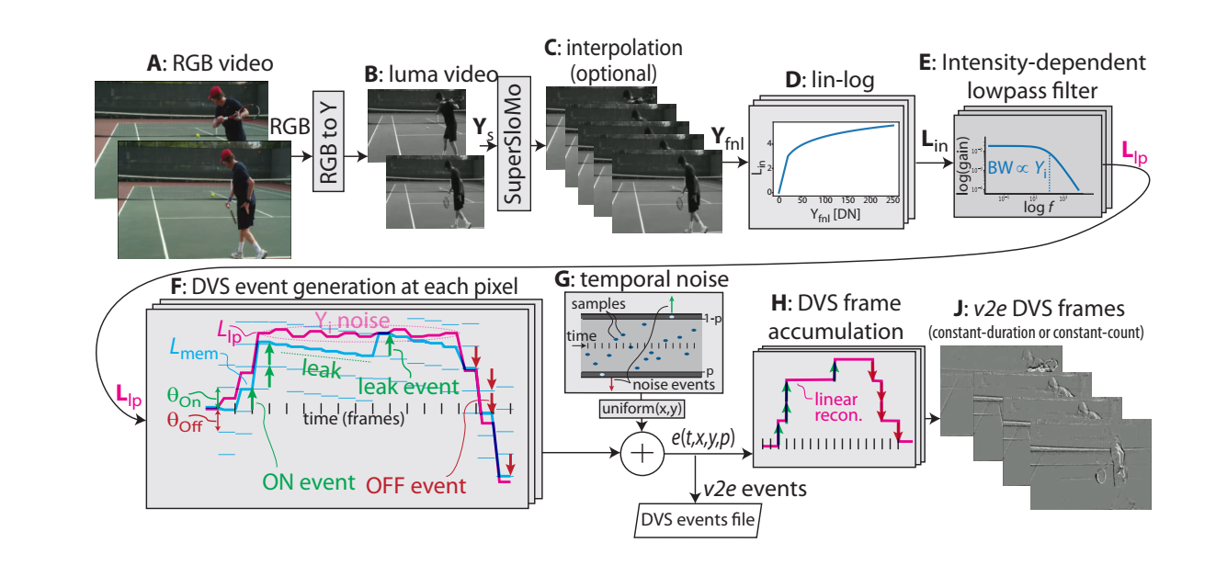
Original V2E Tool
This tool allows creating simulated event data from standard VIS camera inputs.
Yuhuang Hu et al, “v2e: From Video Frames to Realistic DVS Events”
Notes:
בר

Slide 19
Original V2E Tool - Problems
We wanted to created synthetic event streams for simple scenes that we created in Matlab.
The V2E tool included an interpolation step that didn't behave well for our needs.
Additionally, we wanted to inject custom Threshold Mismatch noise in a simpler manner, while excluding other noise sources.
Notes:
בר

Slide 20
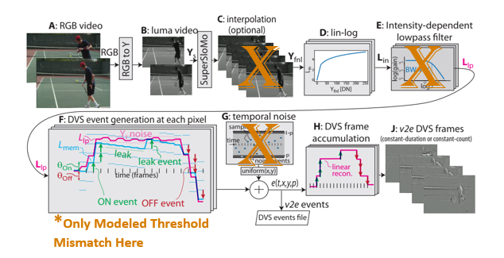
Our V2E Tool
To isolate threshold mismatch and modify the event generation to our needs, we created a new V2E tool.
We synthetically generated high-resolution artificial videos to input to the tool.
Notes:
אסף

Slide 21

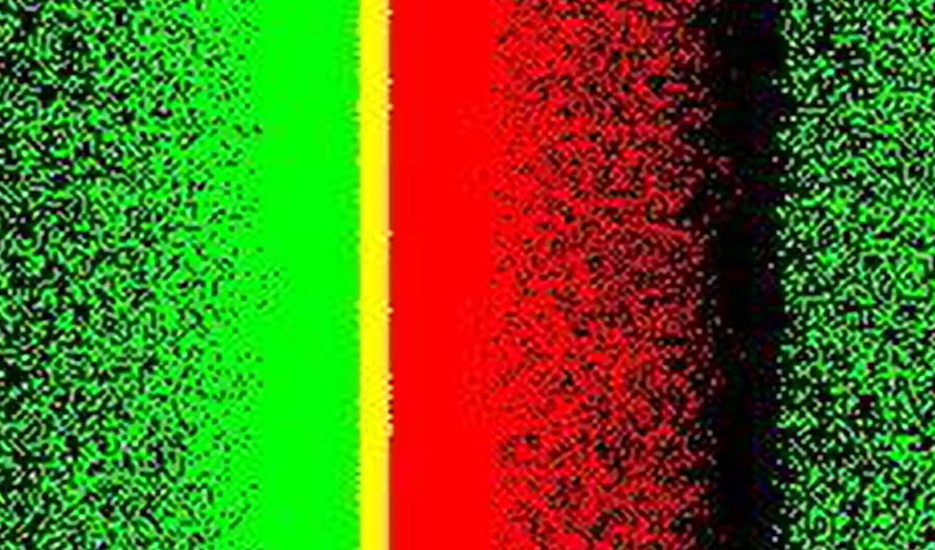
Our V2E Tool – Output Example
Here we can see an example of the tools update
Video
Events
Notes:
אסף

Slide 22
Agenda
Background
Noise Sources
Simulation Environment
Threshold Estimation and Correction
Performance Analysis
Conclusions and Future Work
Notes:
בר

Slide 23
Threshold Estimation
To correct the threshold mismatch effect, first we want to accurately evaluate the threshold of each pixel.
We chose to adapt an estimation method suggested in an article by Ziwei Wang et al.
In this work we don't assume an additional illumination level sensing, and just use a stand-alone DVS.
The estimation is done offline prior to the camera operation.
Ziwei Wang et al, "Event Camera Calibration of Per-pixel Biased Contrast Threshold"
Notes:
בר

Slide 24
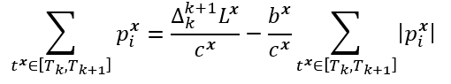
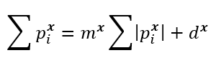
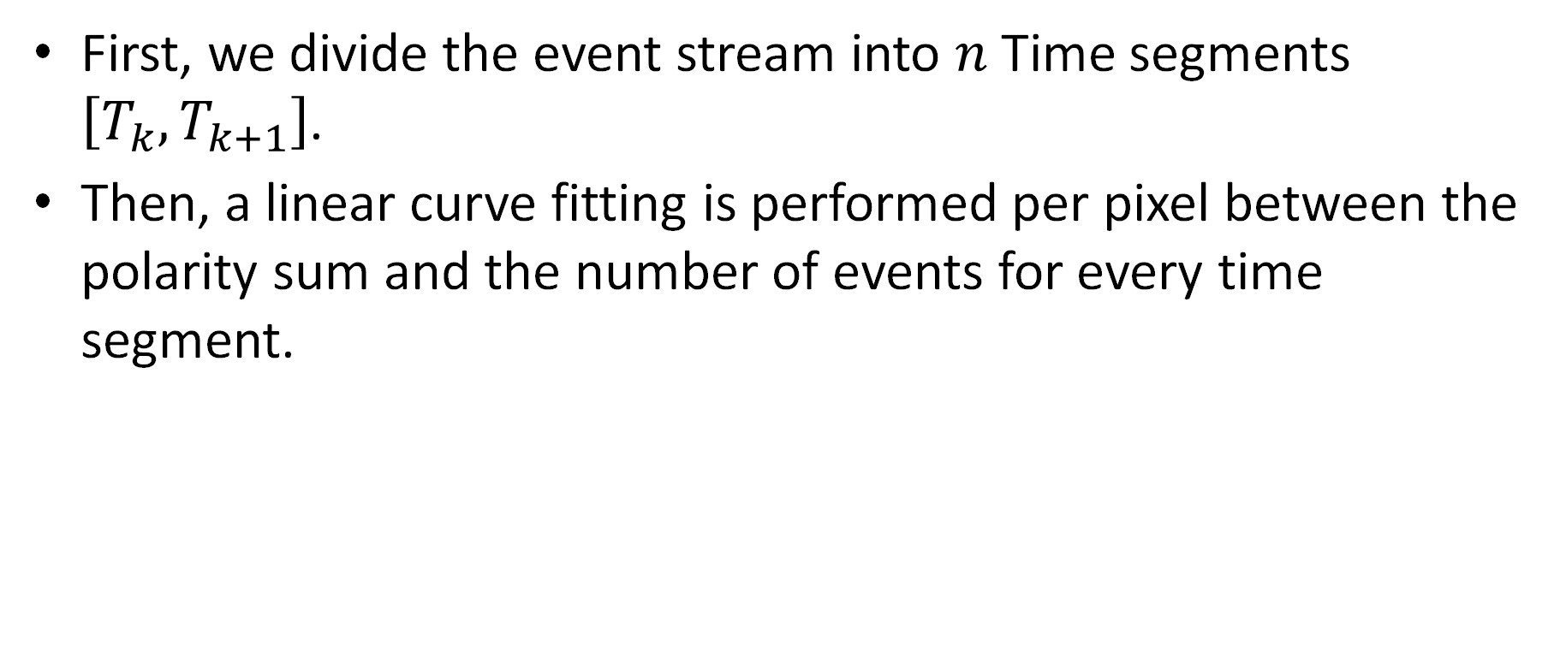
Threshold Estimation Algorithm
First, we divide the event stream into $n$ Time segments $\left[T_{k},T_{k+1}\right]$.
Then, a linear curve fitting is performed per pixel between the polarity sum and the number of events for every time segment.
Ziwei Wang et al, "Event Camera Calibration of Per-pixel Biased Contrast Threshold"
Notes:
אסף

Slide 25
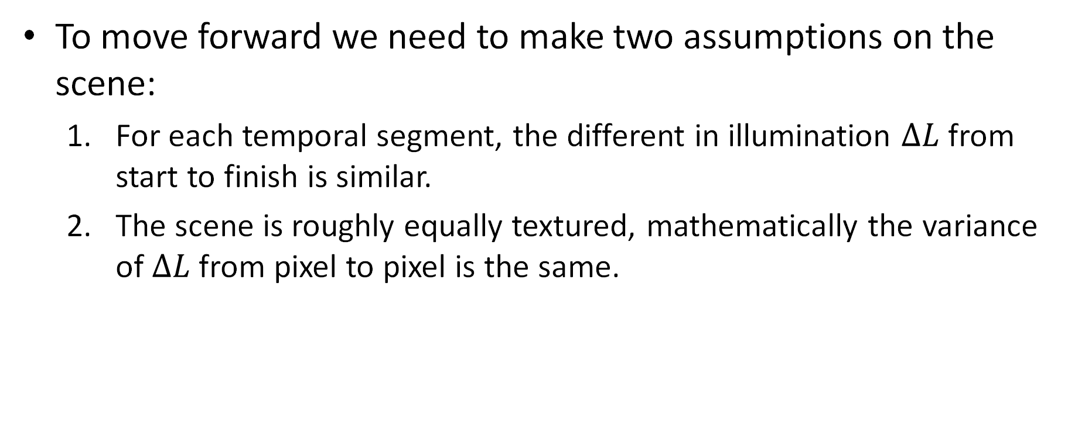
Threshold Estimation Algorithm (Cont. 2)
To move forward we need to make two assumptions on the scene:
For each temporal segment, the different in illumination $ΔL$ from start to finish is similar.
The scene is roughly equally textured, mathematically the variance of $ΔL$ from pixel to pixel is the same.
Ziwei Wang et al, "Event Camera Calibration of Per-pixel Biased Contrast Threshold"
Notes:
אסף

Slide 26
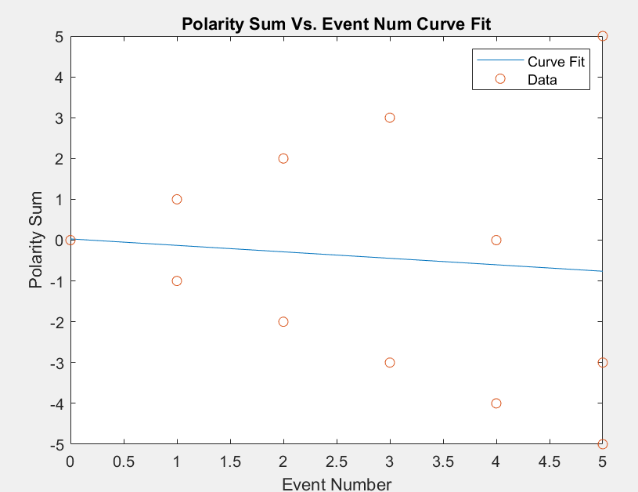
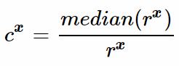
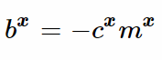
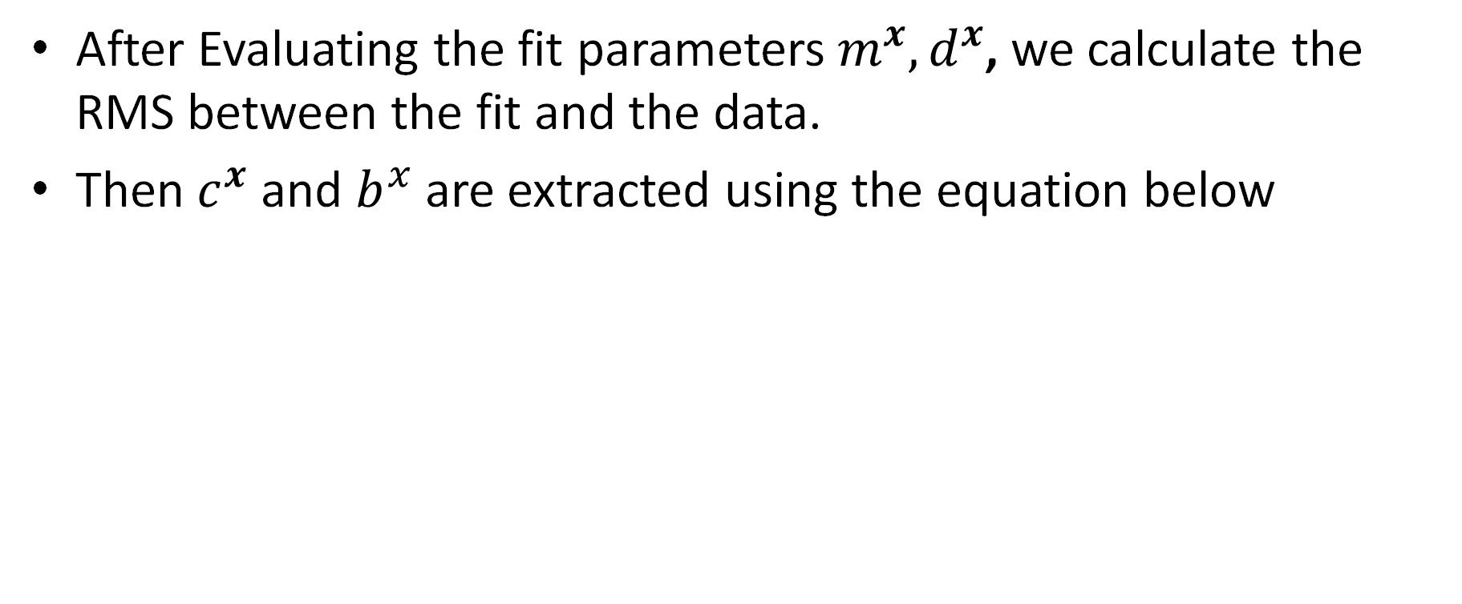
Threshold Estimation Algorithm (Cont. 3)
After Evaluating the fit parameters $m^{x},d^{x}$, we calculate the RMS between the fit and the data.
Then $c^{x}$ and $b^{x}$ are extracted using the equation below
Ziwei Wang et al, "Event Camera Calibration of Per-pixel Biased Contrast Threshold"
Notes:
אסף

Slide 27
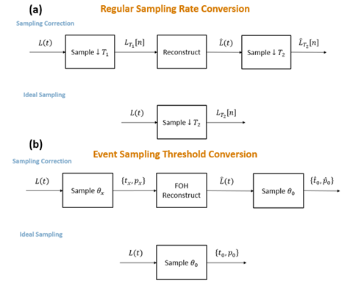
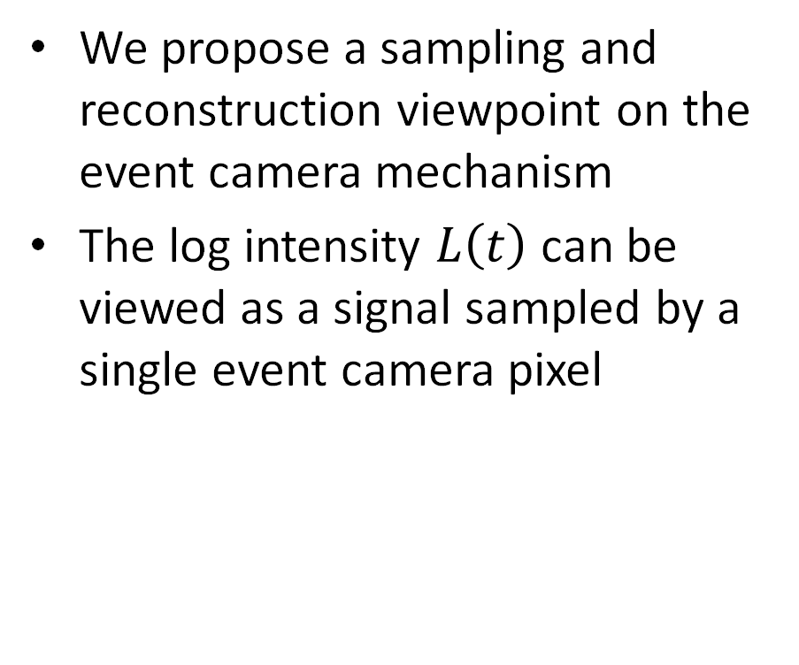
Threshold Correction Algorithm
We propose a sampling and reconstruction viewpoint on the event camera mechanism
The log intensity $L\left(t\right)$ can be viewed as a signal sampled by a single event camera pixel
Notes:
בר

Slide 28
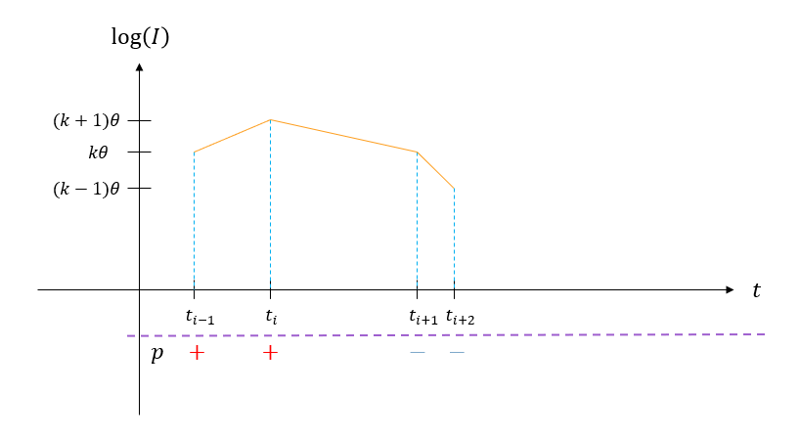
FOH reconstruction
The FOH is a little different than in the case of regular sampling
We use FOH rather than higher orders since its simplicity allows adaptation to real time use, w\o computing the actual reconstruction
Notes:
בר

Slide 29
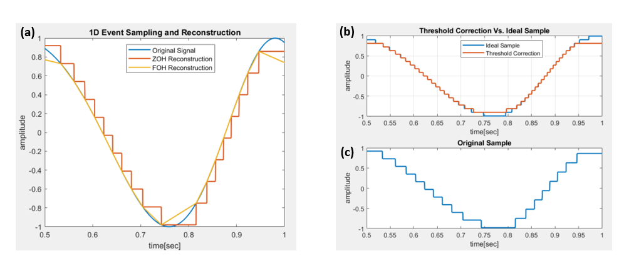
Algorithm Operation Illustration
Notes:
בר

Slide 30
Agenda
Background
Noise Sources
Simulation Environment
Threshold Estimation and Correction
Performance Analysis
Conclusions and Future Work
Notes:
אסף

Slide 31
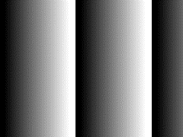

Threshold Estimation Performance
We tested 2 types of scenes
Moving Gradient
Flicker
Notes:
אסף

Slide 32
Estimation Flow
We pass each scene through our v2e tool and then perform the estimation
V2E
Estimation
Notes:
אסף

Slide 33
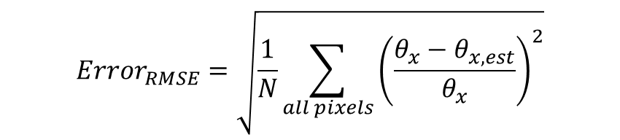
Threshold Estimation Results
Moving Gradient | Flicker
6.04% | 7.07% | Positive Thresholds Error MSE
6.38% | 5.14% | Negative Thresholds Error MSE
$$Error_{RMSE}=\sqrt{\frac{1}{N}\sum_{all pixels}{{\left(\frac{θ_{x}−θ_{x,est}}{θ_{x}}\right)}^{2}}}$$
Notes:
אסף

Slide 34
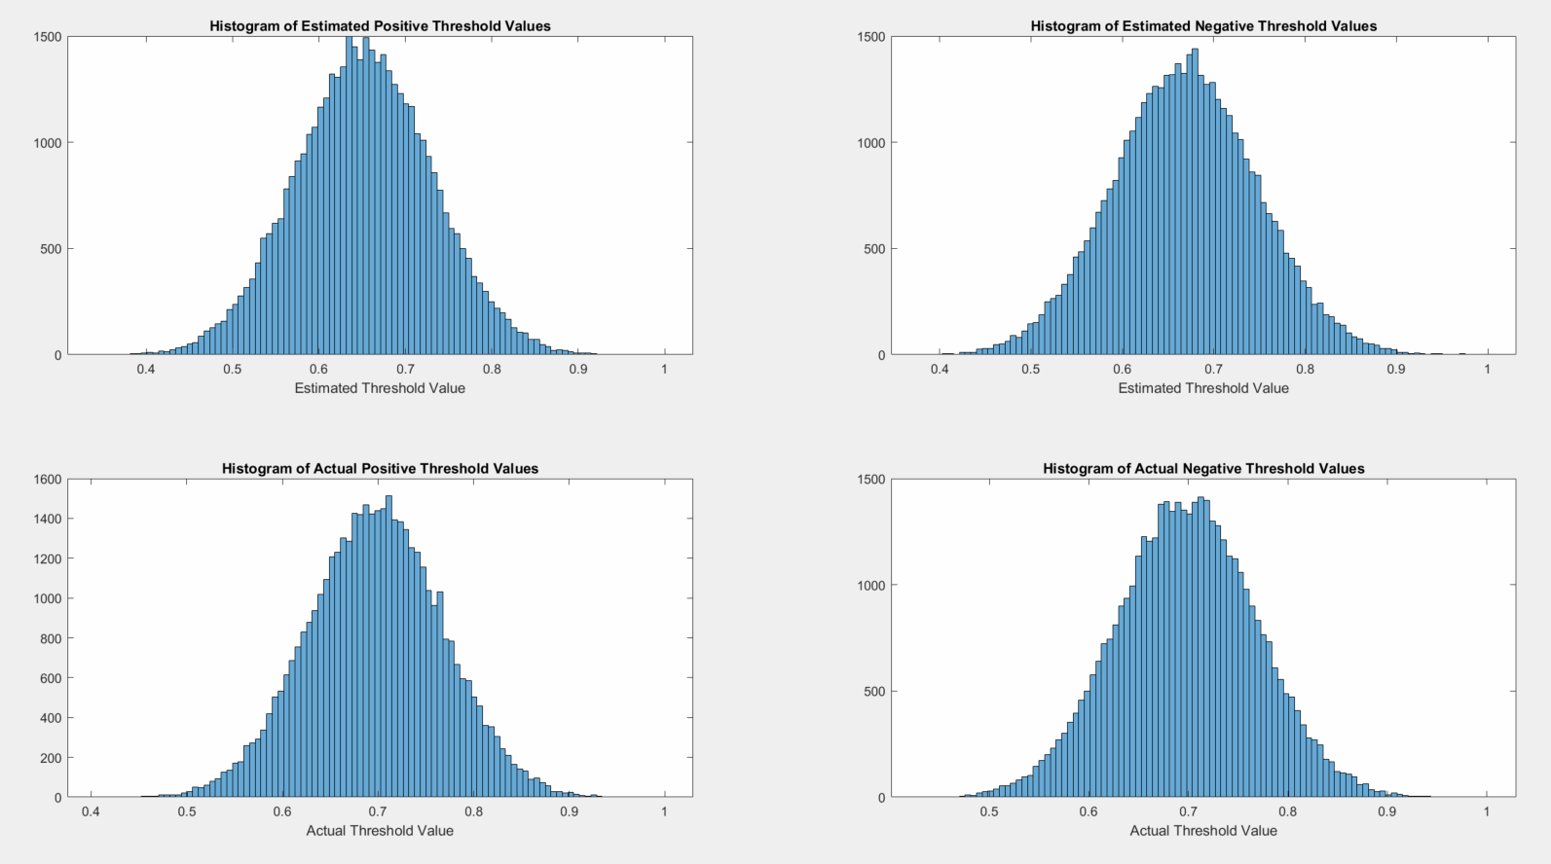
Histogram of Estimated and Actual Thresholds
Flicker Scene
Notes:
בר

Slide 35
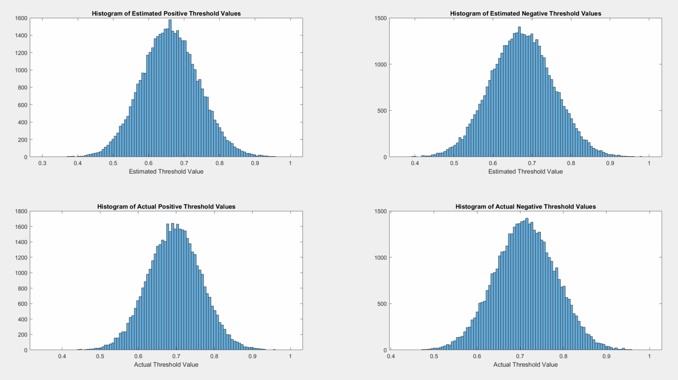
Histogram of Estimated and Actual Thresholds
Moving Gradient Scene
Notes:
בר

Slide 36
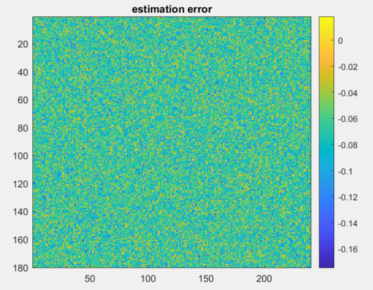
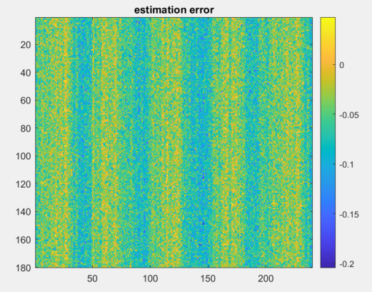
Estimated Thresholds Map
The scene pattern is shown in the estimated thresholds’ map
Flicker
Moving Gradient
Notes:
אסף

Slide 37
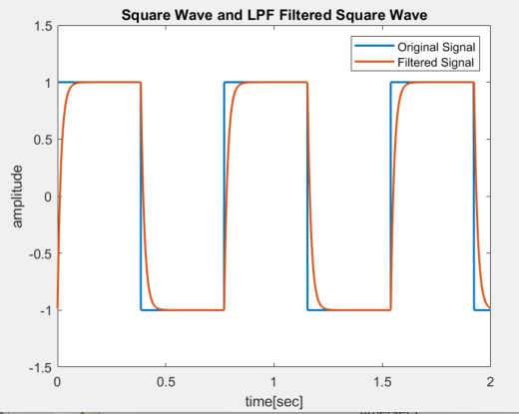
Threshold Correction Performance
The performance of the algorithm is tested on a square wave since realistic scenes are characterized with objects’ edges
The square wave is passed through a single pole LPF to match the capacitors’ frequency response in the sensing circuit
Notes:
בר

Slide 38
Threshold Correction Performance (Cont. 2)
To test the performance of the algorithm we randomize ON and OFF thresholds for 100 pixels
The signal is sampled by each pixel with its threshold
Then the correction algorithm is applied on the sampled signals
Notes:
בר

Slide 39
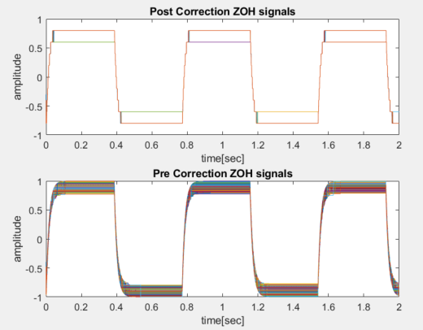
Correction Results With no Estimation Error
We can see that that the corrected signals are more uniform than the signals with threshold mismatch
Notes:
בר

Slide 40
Performance with Estimation Error
As we saw in the estimation algorithm results, we can’t assume that the thresholds are exactly known
To test the effect on the correction algorithm we randomize a gaussian estimation error on the known thresholds
Then the correction algorithm is applied
Notes:
אסף

Slide 41
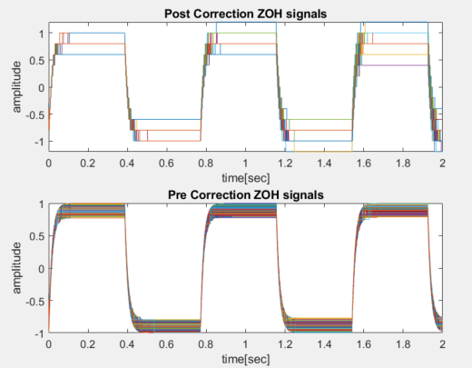
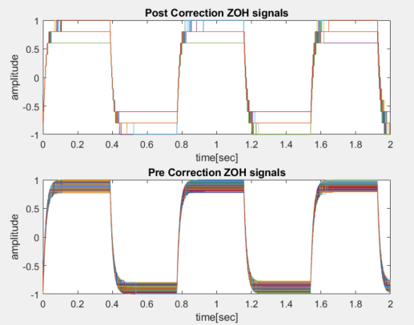

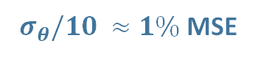
Correction Results With Estimation Error
Since there is an estimation error there is accumulated error in the reconstruction
$σ_{θ} /5≈2\%$ MSE
$σ_{θ}/10 ≈1\%$MSE
Notes:
אסף

Slide 42
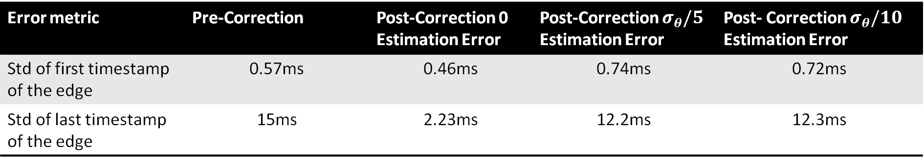
Error Metrics
Some sources refer to the first and last event of each change as the most informative, hence we decided to use them to evaluate the algorithms performance
Post- Correction $σ_{θ}/10$ Estimation Error | Post-Correction $σ_{θ}/5$ Estimation Error | Post-Correction 0 Estimation Error | Pre-Correction | Error metric
0.72ms | 0.74ms | 0.46ms | 0.57ms | Std of first timestamp of the edge
12.3ms | 12.2ms | 2.23ms | 15ms | Std of last timestamp of the edge
Notes:
אסף

Slide 43
Agenda
Background
Noise Sources
Simulation Environment
Threshold Estimation and Correction
Performance Analysis
Conclusions and Future Work
Notes:
אסף

Slide 44
Conclusions
Threshold Estimation
The statistical nature is predicted by the estimation algorithm
5-7% errors was achieved for both positive and negative thresholds
Analysis relatively to ground truth rather than video reconstruction performance
Threshold Correction
The algorithm improves the uniformity between the pixels
New approach to denoising, contrary to removing events
Notes:
בר+אסף

Slide 45
Future Work
Improving Threshold Estimation:
Exploring optimal estimation scenes
Utilizing illumination data to improve accuracy (OffEI/OffE)
Online vs. Offline estimation - don’t assume time invariance
Threshold Correction:
Developing better performance metrics
Develop a more noise-robust method
Exploring higher orders of reconstruction
Test impact of other noise sources on performance
Notes:
בר+אסף

Slide 46

Thank You!

Slide 47
Back Up

Slide 48
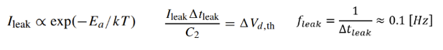
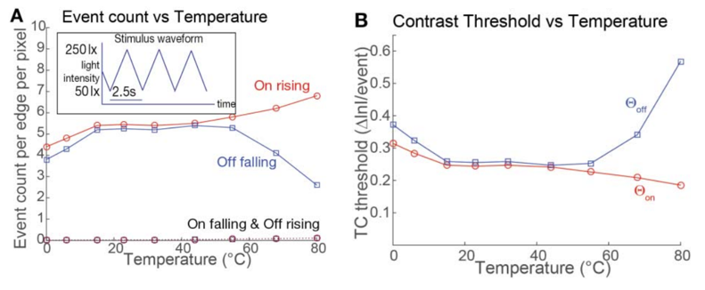
Leak Noise Events
Cause #1: Junction leak current amplified in reset circuit.
Cause #2: Parasitic photocurrent in reset transistor (in non-ideal lighting conditions)
Yuji Nozaki and Tobi Delbruck, “Temperature and Parasitic Photocurrent Effects in Dynamic Vision Sensors”

Slide 49
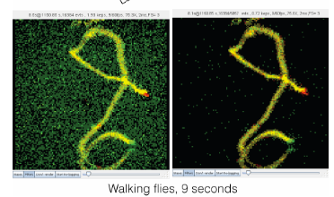
Leak Noise Filtering
Literature usually refers to leak noise as part of "Background Activity".
Usually filtered out through low correlation with neighborhood look-back window.

Slide 50
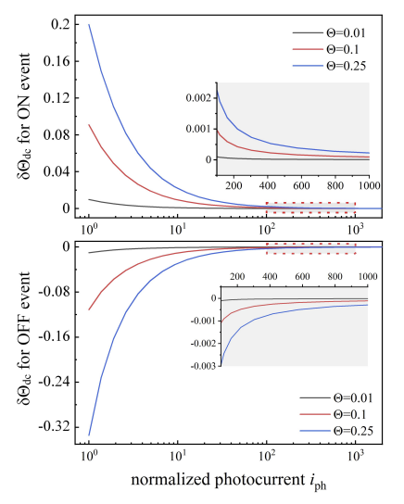
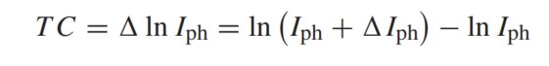
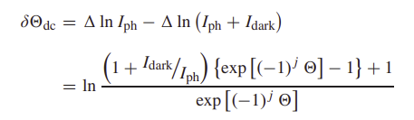
Dark Current
Cause: leakage current in the photodiode that causes the capacitor to charge and emit random noisy events.
This noise has a smaller effect in brighter lighting conditions.
Jiangtao Xu et al, “Analysis of Input-Dependent Noise in Self-Timed Reset Dynamic Vision Sensor and Its Impact on Data Quality”
Notes:
הרבה פעמים מתייחסים לdark current ו-leak noise ביחד, אנחנו בחרנו להפריד בגלל ההשפעה של עוצמת ההארה על ה-dark current בלבד.

Slide 51
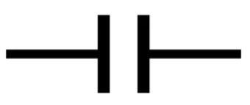
Shot Noise
The quantum nature of photon absorption in photodiodes causes some of the photons to not generate an electron in the diode.
In event cameras on contrary to regular cameras shot noise affects the latency of events instead of the illumination.
True events may be missed, and false events may be added.
Electron generated with probability p
When “full” event generated
Event
e
e
e
e
e
e
e
e
e
e
e
e

Slide 52

Hot / Cold Pixels
Some pixels continuously trigger false events, even with no input, due to defective thresholding / reset.
Similarly, some pixels trigger almost no events for the same reasons.
Shasha Guo and Tobi Delbruck, “Low Cost and Latency Event CameraBackground Activity Denoising”

Slide 53



BA filtering example
We Assume that noisy events have low correlation with past events.
Go through all events and delete uncorrelated events
Alireza Khodamoradi et al, “O(N) Space Spatiotemporal Filter for Reducing Noise in Neuromorphic Vision Sensors”
Notes:
להתייחס בעל פה לסוגי רעשים שהפילטר מסנן, leak noise & dark current

Slide 54


Filtered Frame - Bike
Raw Data
Filtered Data

Slide 55


Estimated Thresholds Map
The scene pattern is shown in the estimated thresholds’ map
Flicker
Moving Gradient
Notes:
אסף

Slide 56
X
X
X
*Only Modeled Threshold Mismatch Here

